Slide 1
Change in prevalence of Chronic Kidney Disease in England over time: comparison of nationally representative cross-sectional surveys from 2003 to 2010
Grant Aitken
3rd Year PhD (Geography & Environment)
Supervisors: Prof Graham Moon & Prof Paul Roderick
Notes:
-Afternoon
-My name is….
-Final year of PhD over at Geog&Env
-Today I will be presenting one small aspect of my PhD which is….

Slide 2
What is Chronic Kidney Disease?
Defined as specific loss of kidney function or damage over a specified time period
Loss of function can lead to a variety of health problems
CKD is usually asymptomatic
CKD can be measured by computing the Glomerular Filtration Rate (GFR)
CKD if GFR less than 60 (Stage 3-5)
Notes:
-Kidneys essential organs as they filter the blood remove waste and control salt balance. Also assist the body to produce red blood cells, maintain blood pressure.
-Complications include high blood pressure, renal bone disease and if untreated death.
-Serum creatinine is used to estimate GFR a measure of the filtering capacity of the kidney. It is produced by muscle breakdown. Causes of CKD include obesity, diabetes and HT as well as diseases of kidney.

Slide 3
CKD: What is unknown
Very limited data on changes in CKD prevalence over time in England
Information on prevalence change is needed to assess the impact of trends in underlying determinants, and of strategies to prevent and manage CKD
Notes:
Have one NHANES study in the USA showing CKD prevalence increased over time, but this was long time age (1988-1994 and 1999-2004)
Several policy initiatives have been introduced in England that have had an impact on prevention, detection and management of CKD. The National Service Framework for Renal Services 2004/05 led to national reporting of eGFR by clinical biochemistry laboratories from 2006,¹² the General Practice pay for performance Quality Outcomes Framework (QOF) included targets for CKD management from 2006/07,¹³ and the NHS Vascular Checks Programme, introduced in 2009, includes screening for CKD (stage 3-5) in people aged 35-74 with newly identified type 2 diabetes or hypertension
Need to know how effective these are (NEED TO ASSESS IMPACT).

Slide 4
Aim
To compare the prevalence of CKD in the nationally representative Health Survey for England (HSE) 2003 with the combined HSE 2009-10 dataset and examine the effects of changes in obesity, diabetes and hypertension prevalence over this period
1) To derive small area estimation models for CKD at a national scale.
2) To explore differences in the geographies of CKD derived from these contrasting estimation models.
3) To assess implications for national CKD prevalence.
Notes:
Here is the aim (as outlined in the abstract) so I will give you a few seconds to digest that.

Slide 5
Methods
Use of 2003 and pooled 2009-10 Health Survey for England (HSE), individuals aged 16+ with valid serum creatinine value (7,850 from 2003 HSE and 6,046 individuals from 2009/10 HSEs)
Used age, sex, ethnicity, socio-demographic factors (household tenure and education status) and clinical factors (smoking, BMI, HDL cholesterol, total cholesterol, doctor diagnosed diabetes and doctor diagnosed hypertension)
Prevalence of stage 3-5 CKD (eGFR<60ml/min/1.73m²) was calculated using the MDRD formula
Multivariate logistic regression modelling was used to adjust time changes for socio-demographic and clinical factors
Notes:
2 formulae CKDEPI and MDRD both take account of muscle mass using age gender race. MDRD routine so will use that, did for more accurate CKDEPI which will come in.
NEED COMMENT ON ASSAY AND THE ASSAY VARIATION

Slide 6
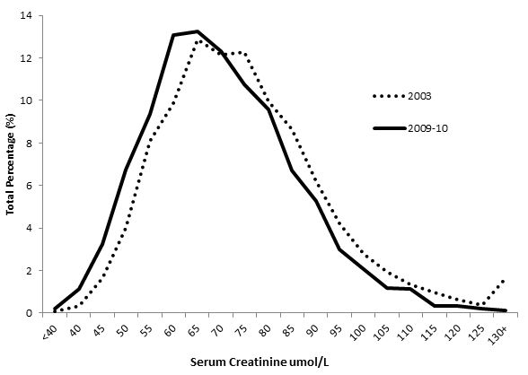
Results: Distribution of eGFR
Prevalence of CKD 3-5 decreased from 9.6% to 6.0% (p<0.001)
Notes:
X-axis shows increasing serum creatinine. A higher serum creatinine value will equate to a lower eGFR value which in turn will equate to a higher prevalence of CKD.
Shift in curve to left implies that the serum creatinine values will be lower in 2009-10, which in turn could imply a lower prevalence of CKD.
We can see that this is the case. CKD prevalence has decreased for formula over these two points in time and it is strongly signifcant.
If this change in prevalence in England is true, then based on the HSE 2003 age-sex-specific estimates and 2001 and 2011 Census data, the estimated number of CKD cases (for those aged 16 and over) would be 3.77 million based on the MDRD equation, falling by 1.18 million for 2009/10.

Slide 7
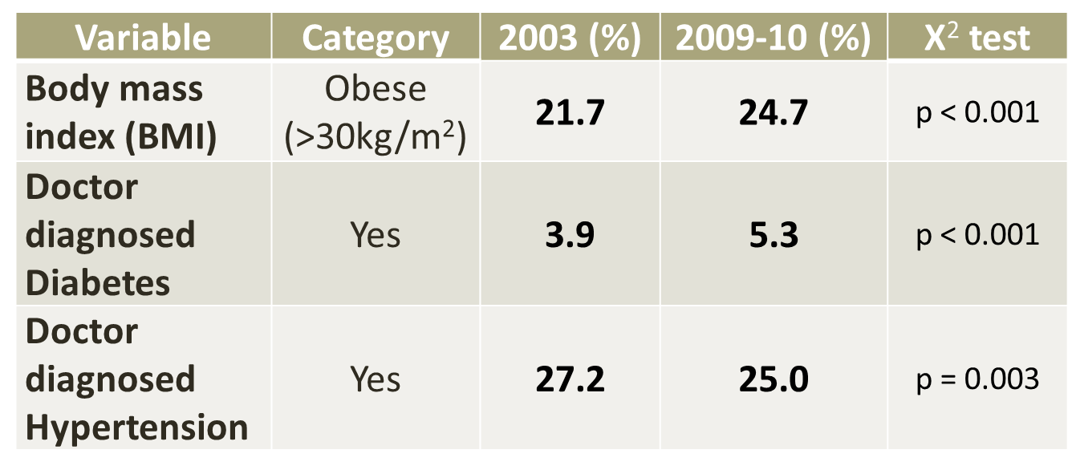
Results: Distribution of BMI, diabetes and hypertension
Notes:
TOP: Prevalence of obesity and hypertension has increased from 2003 to 2009/10. But prevalence of hypertension has fallen.
Now if we have an increase in two conditions which are on the causal pathway to CKD, surely we may expect an increase also? Could it be the case that the decrease in prevalence of hypertension has ofset increases in obesity and diabetes?

Slide 8
Results: Regression Modelling
Variable |  | MDRD
 |  | OR (95% CI)¹ | OR (95% CI)² | OR (95% CI)³ | OR (95% CI)⁴
HSE Year | 2003 | 1 | 1 | 1 | 1
 | 2009-10 | 0.52 (0.45-0.60)** | 0.53 (0.44–0.62)** | 0.48 (0.41–0.57)** | 0.49 (0.42–0.57)**
¹Adjusted for age and sex
²Adjusted for age, sex, ethnicity, tenure and education
³Adjusted for age, sex, ethnicity, tenure, education, smoking, BMI, HDL cholesterol, total cholesterol and doctor diagnosed diabetes
⁴ Adjusted for age, sex, ethnicity, tenure, education, smoking, BMI, HDL cholesterol, total cholesterol, doctor diagnosed diabetes and doctor diagnosed hypertension
Notes:
Did some logistic regression modelling.
ORs constantly show CKD prev decreased from 09-10, even when we adjust for additional socio-economic and clinical covariates. In fact, difference between years gets STRONGER with addition of extra covariates.

Slide 9
Conclusions
The prevalence of a low eGFR indicative of CKD in England has decreased over this seven year period.
This fall was recorded despite rising prevalence of obesity and diabetes, two key causes of CKD. Hypertension prevalence declined but this did not appear to explain the fall.
Potential reasons for the fall in eGFR:
i) chance
ii) artefact of differences in the serum creatinine measurement
iii) changes in serum creatinine production rather than excretion by the kidney
iv) residual confounding by differences in sample characteristics not adjusted for by sample weighting
v) true fall in eGFR

Slide 10
Future Research
There is a need for repeated national prevalence estimates to further assess CKD patterns over time
Periodic assessment of eGFR in future HSEs is needed to evaluate trends in CKD
Use measures of albuminuria and Cystatin C, both of which were available in HSE 2009 and 2010
Notes:
NEED TO SAY WHY CYS C..NEWER MEASURE NOT DEPENDENT ON MUSCLE MASS
In my PhD we use other fomulae to examine CKD prevalence at the small area level throughout England (we compare time also)

Slide 11

Thank you! Any Questions?
E-mail: G.Aitken@soton.ac.uk
Twitter: G_Aitken1

